Slide 1
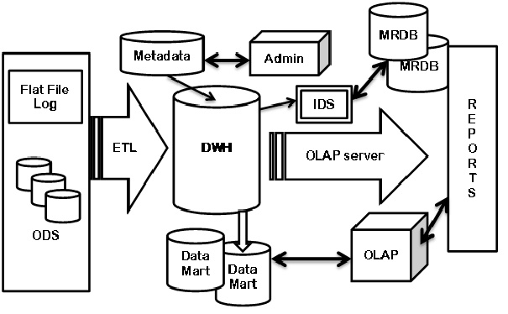
DATA WAREHOUSE
TOPICS:
1.Introduction
2.Top down approach vs Bottom up approach
3. Datawarehouse architecture
4.OLAP VS OLTP
5. ODS VS DWH
6. Master tables vs Transition tables
7.Dimension modeling
8. Designing steps of DWH
9.DWH schemas
10.Dimensions and Facts.

Slide 2
What is a data warehouse ?
Data Warehousing integrates data and information collected from various sources into one comprehensive database
What is data mart?
A data mart is a data storage system that contains information specific to an organization's business unit in DWH.
Data mart is a subject oriented and also another data base.
History of DWH
1980 DWH was invented
Dr. Bill h Inmon Was father of DWH
Dr. Ralph Kimball was invented dimension modelling to design DWH in 1990

Slide 3
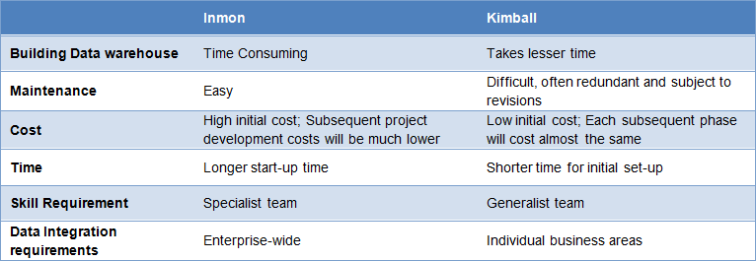
Top down approach vs Bottom up approach

Slide 4
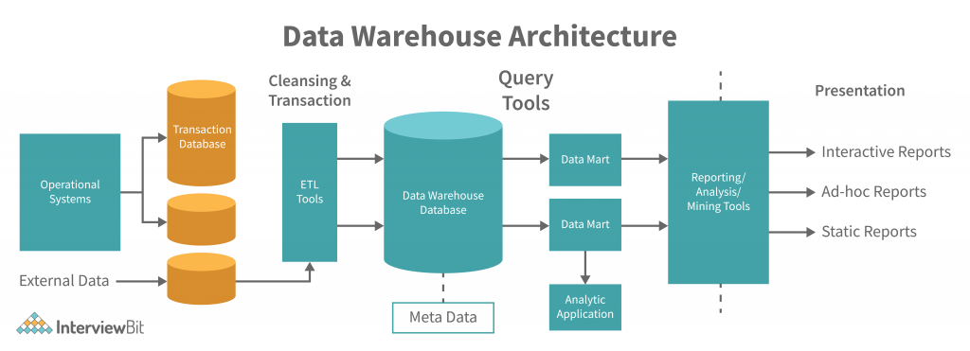

Slide 5
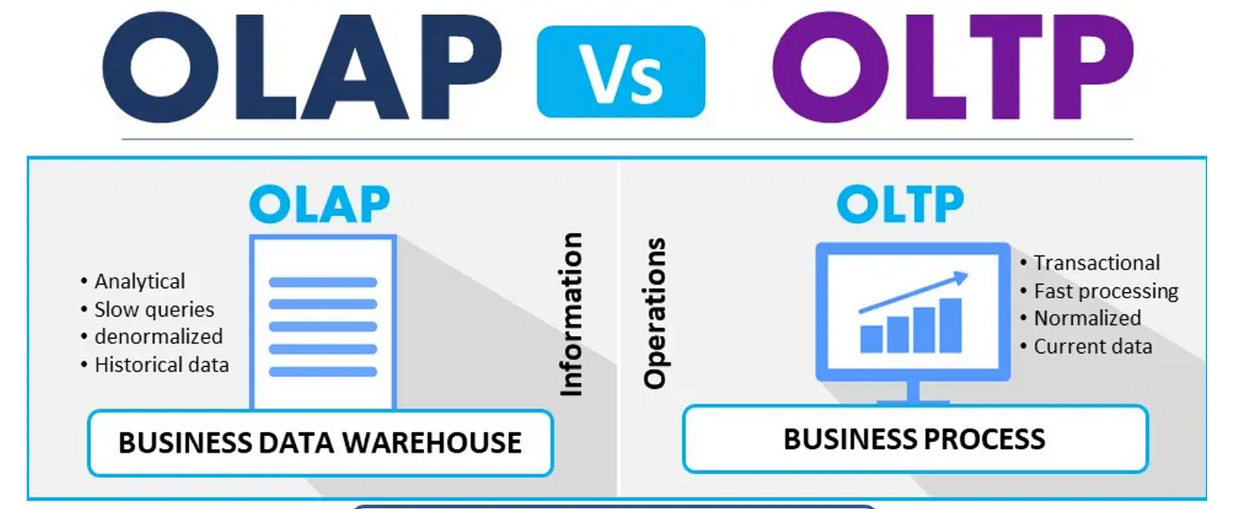
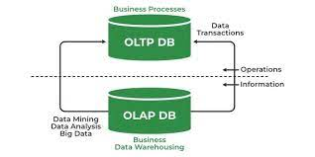
OLTP VS OLAP

Slide 6
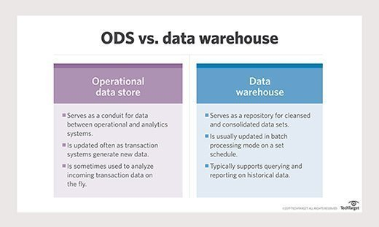
ODS VS DWH

Slide 7
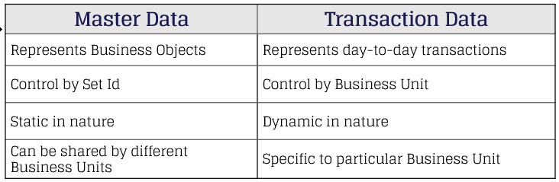
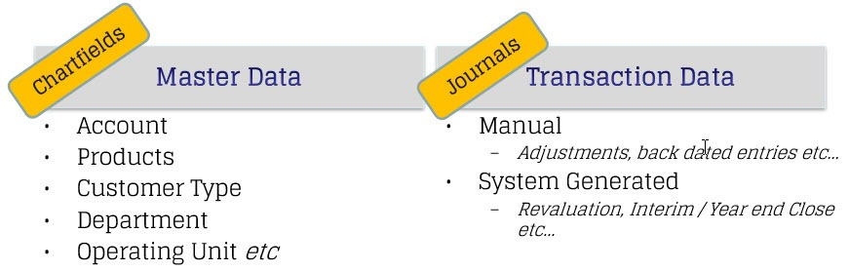
MASTER TABLES VS TRANSATION TAABLES

Slide 8
OLTP TO OLAP TABLES CONVERSATIONS
OLTP
Master tables
Product
Course
Student..Etc
Transaction tables
Payment details
Order details
In OLAP
Master tables converted as Dimensional tables
Transaction tables converted into Facts tables
Dimension modeling:
Dimensional data modeling is a technique used in data warehousing to organize and structure data in a way that makes it easy to analyze.
Designing Datawarehouse:
1.Study the existing OLTP DB and its tables
2.Study the existing reports.
3.Futre requirements /dashboards.
4.Load the data by using ETL
5. Create blank tables
6.Dim = incremental loading
facts =fully loading.

Slide 9
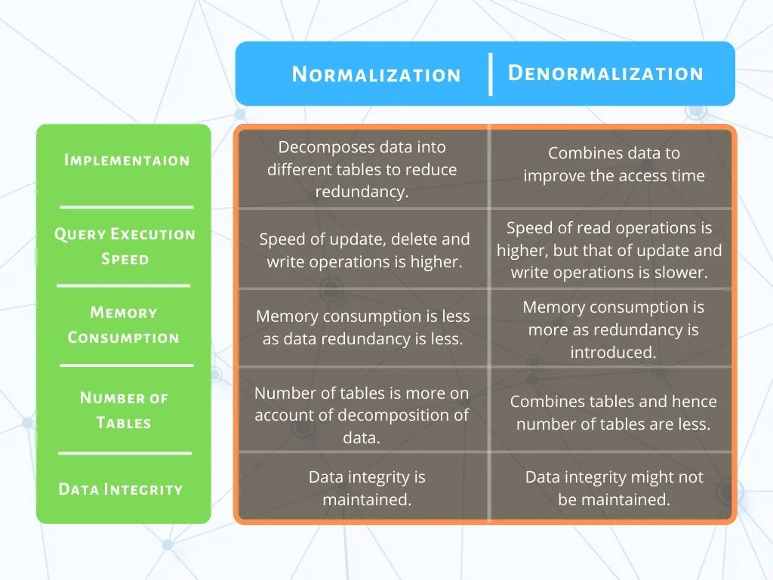

Slide 10
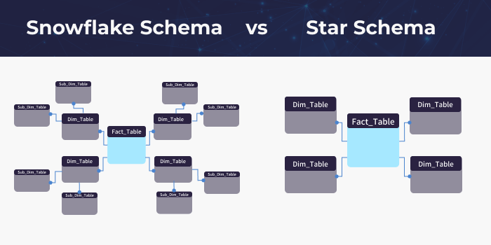
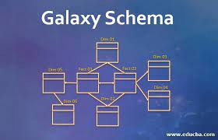
DATA WAREHOUSE SCHEMAS:
1.STAR : A star schema is a type of relational database schema that is composed of a single, central fact table that is surrounded by dimension tables.
2.SNOW FLAKE:A snowflake schema is a multi-dimensional data model that is an extension of a star schema, where dimension tables are broken down into subdimensions.
3.GALAXY:Unlike the Star Schema and Snowflake Schema, the Galaxy Schema uses multiple fact tables connected with shared normalized dimension tables

Slide 11
TYPES OF DIMENSIONS:
1: Role playing dimension
2.Conformed dimension
3.Junk dimension
4.Degenerated dimension
5.Slowely changing dimension
6.Rapidly changing dimension
7.Inferred dimension.
TYPES OF FACT TABLES:
1.Fully additive measures/facts
2.Semi additive measures/facts
3.Non additive measures/facts
4.Derivedd or calculated measures/facts
5. Fact less measures/facts
6.Textual measures /facts
Papered by:
Harish Madapakula

